Slide 1

EU and UK Energy System Planning
2030 and 2050
A presentation to the Institute for Nuclear Energy Research
Taipei August 5th 2015
Paul Ekins
Professor of Resources and Environmental Policy and Director
UCL Institute for Sustainable Resources
Deputy Director, UK Energy Research Centre

Slide 2

Structure of presentation
The challenges of energy and climate change
Results from CECILIA 2050: Combining Policy Instruments to Achieve Europe's 2050 Climate Targets
EU and UK energy and climate policies
UK energy system planning
Conclusions from CECILIA2050
Choosing Efficient Combinations of Policy Instruments for Low-carbon development and Innovation to Achieve Europe's 2050 climate targets

Slide 3
UKERC’s Energy 2050 Project (2007-09)
Energy systems are seamless webs of connected technical and social components. Changing any part of the system is likely to have consequences elsewhere
Decarbonisation implies a fundamental remaking of the system, but system complexity and heterogeneity mean that no single optimal pathway can be confidently defined to respond to the challenge
Multiple possible pathways exist for an affordable transition
Realising this potential faces practical challenges and requires strong, sustained and adaptive policies
Notes:
3

Slide 4
The Energy Trilemma
The objectives of energy policy for many countries are basically three:
Transition to a low-carbon energy system (involving cuts of at least 80% in greenhouse gas (GHG) emissions by 2050, which will require the almost complete decarbonisation of the electricity system), and a wider ‘green economy’
Increased security and resilience of the energy system (involving reduced dependence on imported fossil fuels and domestic system robustness against environmental, economic, social and geo-political shocks)
Affordability
  For businesses: need for competitiveness (some sectors will decline as others grow – allow time for the transition) and cost efficiency (ensuring that investments, which will be large, are timely and appropriate and, above all, are not stranded by unforeseen developments)
  For vulnerable households: need to be able to pay energy costs
Only the first of these objectives is relatively recent.
Outcomes on the other two will depend on how and how vigorously the decarbonisation objective is pursued.

Slide 5
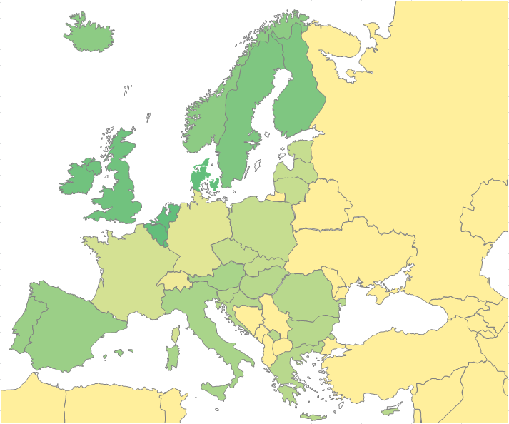
Decarbonising the European Energy System:
European TIMES Model (ETM-UCL)
  Technology-rich, bottom-up dynamic partial equilibrium model with inter-temporal objective function minimising total discounted system costs.
  Supply and demand use sectors modelled, with energy service demands projected using exogenous drivers such as GDP and population projections. 2010 base year.
  11 European regions, linked through trade in crude oil, hard coal, pipeline gas, LNG, petroleum products, biomass and electricity. ‘Global’ region acts as ‘basket of resources’ from which energy products (except electricity) may be imported.
NOI
UKI
SDF
BNL
DEU
EEN
FRA
IBE
IAM
EES
Notes:
Regions – Germany and France on their own, UK & Ireland also separate

Slide 6
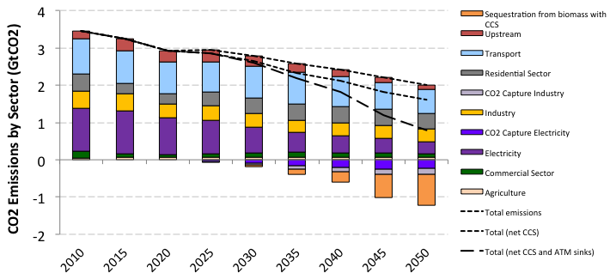
CO₂ Emissions
3 Scenarios – ‘Reference’, ‘Fragmented Policy’ and ‘Policy Success’
‘Policy Success’ scenario – CO₂ 80% below 1990 levels by 2050
Power sector largest contributor to abatement (producing net negative emissions by 2050) (152% reduction from 1990 levels)
Energy commodity prices for oil, coal and gas equal to IEA’s 2012 2-degree scenario levels (2DS, lower prices than reference scenario – reduced global demand)

Slide 7
Power Sector
Policy success
Renewables generation grows to 45% by 2050 – including use of biomass with CCS
Nuclear retains roughly constant capacity (and generation) – exogenous constraint
Fossil fuel (mainly gas) retains ~15% share (half with CCS)
CO₂ intensity from 350gCO₂/KWh in 2010 to -50gCO₂/Kwh in 2050
Renewables capacity grows more than generation

Slide 8
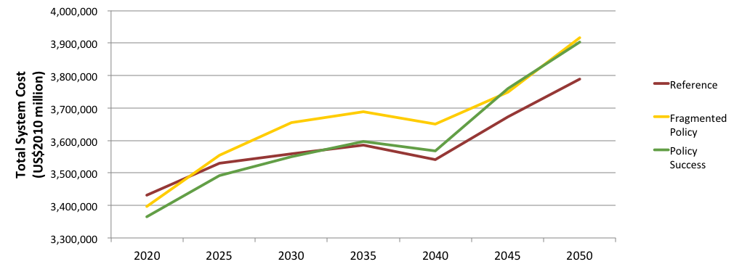
Total System Cost
Net Present Value (NPV) of energy system in ‘Policy Success’ Scenario = $33.2tn
14% higher than Reference scenario, equal to 1.26% projected GDP between 2010 and 2050

Slide 9
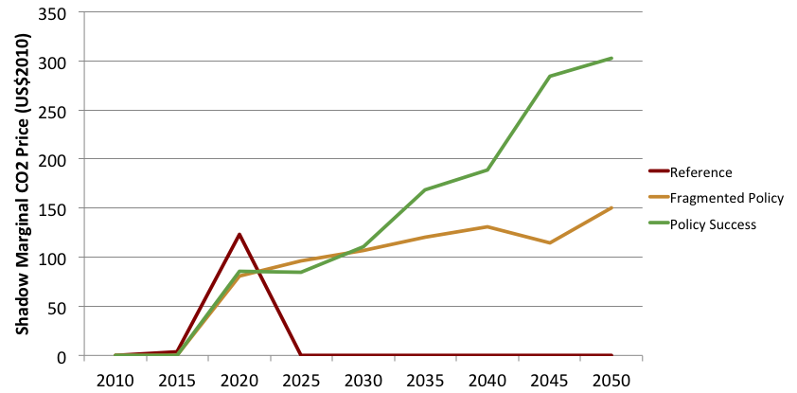
Average Marginal CO₂ Abatement Cost
Peak in 2020 (~$100/tCO₂), to meet 2020 obligations
Policy Success reaches €300/tCO₂ by 2050 (€150/tCO₂ in ‘Fragmented Policy’)

Slide 10
An unprecedented policy challenge
The Stern Review Policy Prescription
Carbon pricing: carbon taxes; emission trading
Technology policy: low-carbon energy sources; high-efficiency end-use appliances/buildings; incentivisation of a HUGE investment programme
Remove other barriers and promote behaviour change: take-up of new technologies and high-efficiency end-use options; low-energy (carbon) behaviours (i.e. Less driving/flying/meat-eating/lower building temperatures in winter, higher in summer)
Carbon pricing will support the other two two policy dimensions

Slide 11
Categorisation of environmental policies
Market/incentive-based (also called economic) instruments: include emissions trading, environmental taxes and charges, deposit-refund systems, subsidies (including the removal of perverse subsidies), green purchasing, and liability and compensation.
Regulation instruments, which seek to define legal standards in relation to technologies, environmental performance, pressures or outcomes. Can also include imposition of obligations, e.g. renewable and energy efficiency obligations in the UK.
Voluntary/self-regulation (also called negotiated) agreements between governments and producing organisations. Economic actors may enter into these in order to forestall the introduction of market-based instruments or regulation.
Information/education-based instruments e.g. Eco-labels, ‘smart’ meters, may be mandatory or voluntary.
Innovation instruments: R&D budgets, capital allowances for investment, public/private partnerships for demonstrations

Slide 12
Policy pillars
H
Highest relevance
1
2
3
M
Medium relevance
L
Lowest relevance
Standards & Engagement
Markets & Prices
Strategic Investment
Domain
To deliver
H
M
L
L/M
H
L/M
L
M
H
Smarter choices
Satisfice
Optimise
Cleaner products & processes
Transform
Innovation & infrastructure
Solutions need to harness corresponding policy pillars based on the three domains, to transform energy systems
Source: Grubb, M. 2014 Planetary Economics, Routledge, London/New York
Notes:
In book order

Slide 13
Application of the framework
Need for credible, stable, consistent, predictable energy and climate policy, employing some mix of:
Carbon pricing: taxes and trading, mixed systems (ETR, BTAs) (Domain 2)
Technology deployment support for low-carbon supply (FiTs/obligations) (Domain 3)
R&D for breakthrough technologies (CCS, storage) (Domain 3)
Regulation for efficiency in demand (Domain 1)
Information for sustainable consumption (Domain 1)

Slide 14
The EU 20/20/20 by 2020 Programme
20% cuts in carbon emissions (30% with international cooperation)
20% of renewable energy in final energy demand
20% reduction in energy use (below what it would otherwise be)
Targets rolled out to Member States
  E.g. UK 15% renewable energy by 2020; 16% cuts in GHG emissions from 2005 level from non-traded sector

Slide 15
EU energy and climate policy instruments
Source: Drummond, P. 2013 ‘The European Union’, report in the CECILIA2050 project (‘Choosing efficient combinations of policy instruments for low-carbon development and innovation to achieve Europe’s 2050 targets’)
IPPC also seeks to promote energy efficiency

Slide 16
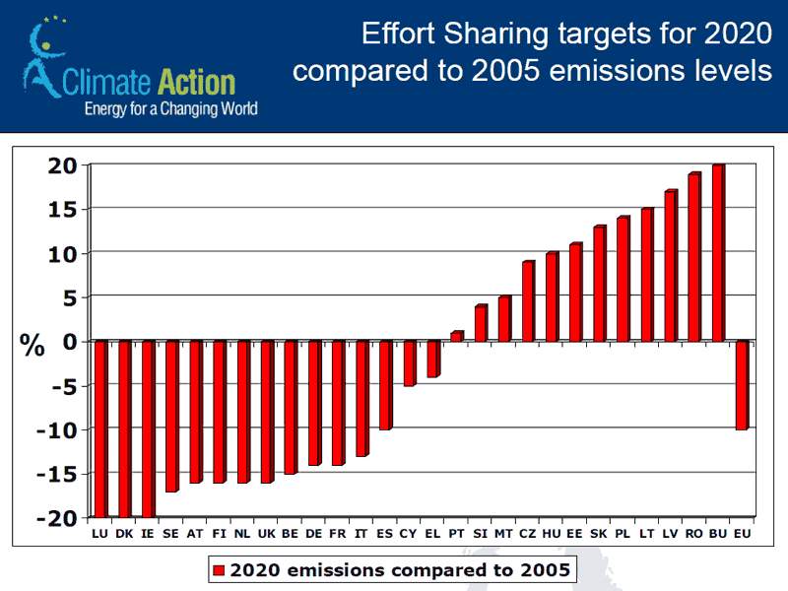
ESD (Effort Sharing Decision on energy efficiency)
Source: http://ec.europa.eu/clima/policies/effort/index_en.htm)

Slide 17
The EU 2030 Proposals
40% cuts in carbon emissions (perhaps more with international cooperation)
27% of renewable energy in final energy demand EU-wide, 27% target for energy efficiency BUT
No targets for Member States (so 27% purely aspirational and close to business-as-usual anyway)
‘Backloading’ EU ETS emission permits in an attempt to support the EU ETS price; further reform post-2020

Slide 18
The rationale for environmental taxation
Market failure leading to excessive pollution and environmental destruction
More efficient than regulation; more effective than voluntary agreements and information
The tax rate needs be set according to one of three aims:
  Internalise external costs (Pigouvian tax 1932, need to know damage costs)
  Achieve standards set on the basis of science and political feasibility (standards and pricing approach, Baumol and Oates, 1978)
  Need to stimulate investment in desired alternatives (e.g. low-carbon, waste management technologies, cf UK Landfill tax)

Slide 19
The rationale for energy taxation
Energy demand increases with income
(income elasticity +0.5)
Energy demand decreases with price
(industry elasticity -0.6)
Market failures for some energy efficiency technologies
Improvements in energy efficiency lead to a rebound effect, and therefore save less energy than anticipated (up to 70%)
Humans are extremely ingenious at finding new ways to use energy (heating drives, gardens, making artificial snow etc.)

Slide 20
Economic instruments: Green Taxes in the EU
Carbon-energy taxes:
  Tax is a Member State (MS) competence, unanimity required
  Differences in MS environmental taxation undoubtedly distort the single market
  European Commission initially favoured a carbon-energy tax, but infeasibility led it to adopt EU ETS in order to have an EU instrument in response to Kyoto Protocol
  Energy Taxation Directive (2003) – low minimum energy taxes – was ultimately agreed
  Unanimity on further EU stand-alone green tax initiatives in EU28 seems unlikely
  Might be a case for more limited agreement, or for relaxing the unanimity requirement, if there is a case for EU-wide green taxes
  Possible revision of Energy Taxation Directive – carbon and energy components

Slide 21
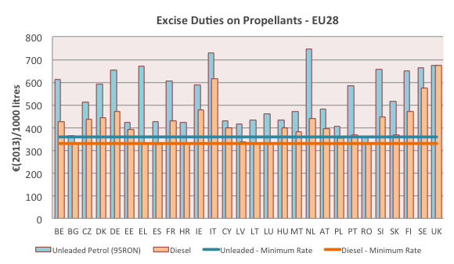
Energy Taxation Directive (ETD) – minimum and actual rates applied on gasoline and diesel
Notes:
Example of difference between Member States for road transport. Diesel rate: €330/1000l, Petrol rate: €359/1000l

Slide 22
Proposal to revise the Energy Tax Directive
Split the tax into two components: carbon (€20/tCO2) and energy (€9.6/GJ motor fuels; €0.15/GJ heating fuels, inc. electricity)
Green Budget Europe et al. critique
  Rates too low (would require 23% increase just to account for inflation since 2004)
  Link to EU ETS price too weak – carbon tax component will need to increase faster to achieve necessary emissions reduction
  Removal of voluntary exemption of household fuels
  Include aviation/shipping, nuclear fuel, biofuels as appropriate
  Inclusion of all East European MS
Prospects for agreement? Slim, given the politics and unanimity decision requirement
Proposal now withdrawn

Slide 23
What are the obstacles to carbon taxes in Europe?
Required unanimity on taxation in the EU Council
Differences in national contexts and tax cultures
Desire in some member states to keep taxation at exclusively national level
Political opposition to green taxes in some MS
Perceived competition with EU ETS

Slide 24
Prospects for environmental taxation in the EU
The future of environmental taxation in the EU depends on a number of factors
  International agreement/commitment to emissions reduction – there is a limit to how long or how far the EU will go it alone
  The rise or decline of Euroscepticism in countries like the UK – greater harmonisation of environmental taxes at an EU level is clearly rational, but this may make little difference to Eurosceptic politics
  The playing out of the Eurozone crisis – greater fiscal coordination in the Eurozone may open the door to greater harmonisation of environmental taxes in the seventeen countries of the Eurozone
  Agreement around the Energy Tax Directive, but very unlikely given unanimity requirement
  A small group of EU countries, coming to the conclusion that environmental taxation is the best way for them to meet their own environmental policy objectives, may coordinate their policies informally, e.g. the Green Growth Group of EU countries
  The Semester Process may encourage Member States to increase their use of environmental taxes

Slide 25
Economic instruments:
Emissions Trading in the EU (1)
EU Emissions Trading Scheme (EU ETS)
  Phase 1: 2005-2007
  Phase 2: 2008-2012
  Phase 3: 2013-2020
  Speedy introduction of EU ETS a remarkable achievement; widely regarded as path-breaking, essential foundation for global emissions trading for climate change mitigation
  Nevertheless, not without problems
  Emissions reduction policies affect the permit price, not emissions, once the cap has been set

Slide 26
Economic instruments:
Emissions Trading in the EU (2)
Emissions trading – issues and problems:
  New sectors (aviation)
  Interactions with other schemes
    Different MS National Allocation Plans distort competition in EU markets
    Volatile allowance market and low carbon prices give little assurance for low-carbon investment
    Calls from business for ‘predictable carbon price’ (although full predictability incompatible with trading)
    Permit price pass through - evidence of ‘windfall profits’, especially in power generation
    Widespread agreement that more allowances need to be auctioned
    Decision to hold back allowances from 2019 to support ETS price – Market Stability Reserve

Slide 27
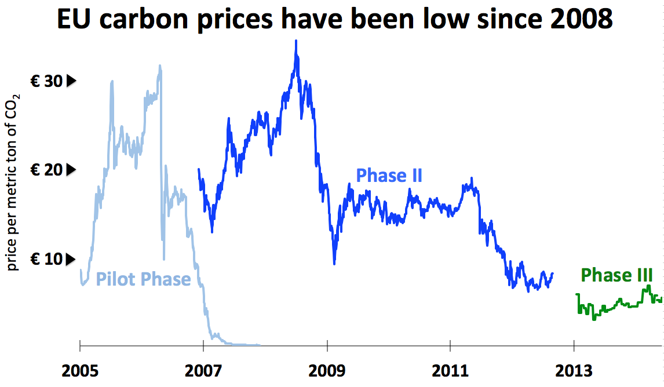
The price of CO₂ under the EU ETS
Source: Environment Agency and Intercontinental Exchange, http://daily.sightline.org/2014/07/02/four-carbon-pricing-pitfalls-to-avoid/eu-carbon-prices-have-been-low-since-2008-chart-courtesy-of-european-environment-agency-and-intercontinental-exchange-used-with-permission/

Slide 28
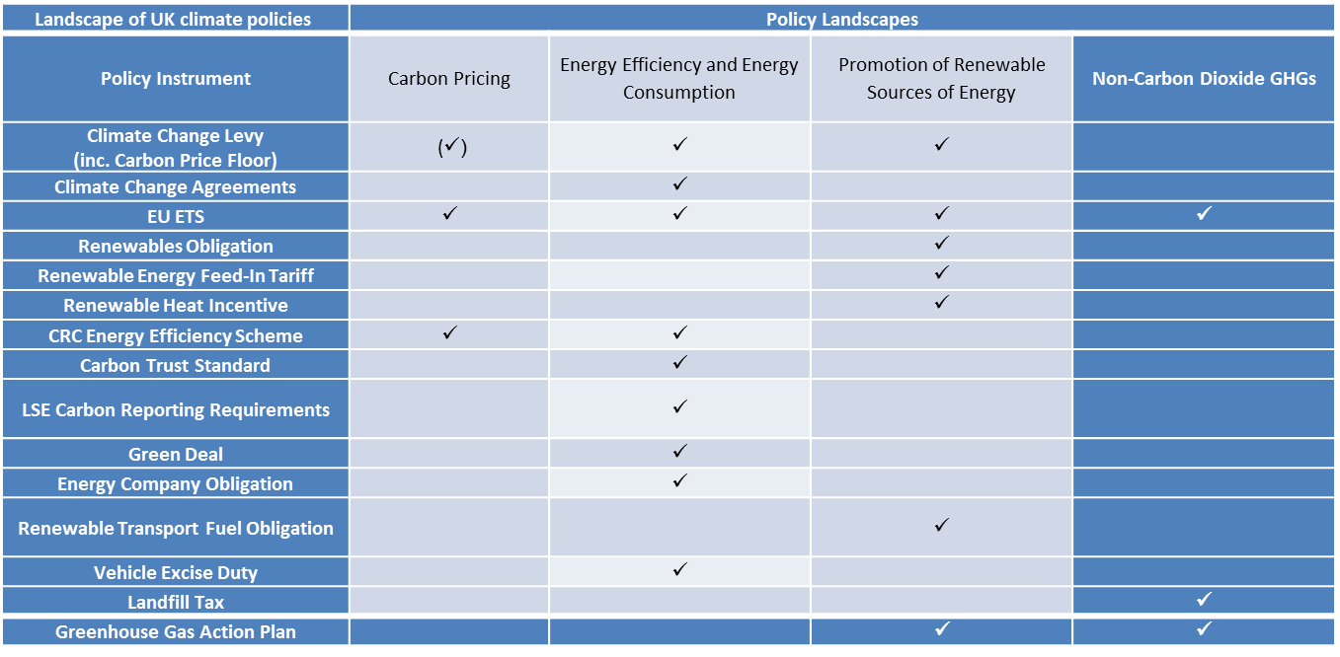
Landscape of UK climate policies

Slide 29
Variability in energy consumption
Source: DECC Heat Strategy, 2012, p.12 (daily consumption also relevant)

Slide 30
UK Policies for carbon decoupling (1)
  Huge policy innovation over the last ten years; we know what to do
  Limited results from these policies; we don’t apply the policies hard enough
  Many policies need local implementation/enforcement
  Economic instruments: importance of resource and emission prices, driver of efficient use, emission and waste reduction
    Energy taxes: climate change levy (carbon reduced by 3.5 mtc by 2010), fuel taxes (EU emissions half what they would have been at US prices)
    Emissions trading: EU ETS; CRC (Carbon Reduction Commitment) Energy Efficiency Scheme (converted into a tax)
    Feed-in-Tariffs for small-scale renewable electricity generation (degression)
    Renewable Heat Incentive
    Green Deal
    Green Investment Bank
    Capital grants, demonstration projects

Slide 31
UK Policies for carbon decoupling (2)
  Regulation
    Renewables Obligation; Renewable Transport Fuel Obligation
    Carbon Emissions Reduction Target , Energy Company Obligation
    Integrated Pollution Prevention and Control (control of non-carbon emissions may increase carbon emissions)
    Building Regulations (zero-carbon buildings)
  Voluntary agreements
    Climate change agreements
    EU fuel efficiency agreements (targets not met); targets now mandatory (i.e. Regulation)
  Information/education
    Energy efficiency labels for appliances and vehicles (e.g. A-rated fridge freezers 0-80% market share in 6 years)
    Smart meters and energy billing
    Energy Saving Opportunity Scheme (ESOS)
    Act on CO2

Slide 32
UK Policies for carbon decoupling (3)
  Energy market reforms
    Post-war: nationalisation (high R&D; low efficiency; nuclear)
    1980s: privatisation (low R&D; low prices; sweating assets – little investment; change from central dispatch to Pool to NETA/BETTA)
    Market not fit to response to challenges of decarbonisation and energy security
  Energy/electricity Market Reform
    Carbon support price (extension of CCL to fossil fuel inputs into electricity production)
    Feed-in Tariffs (fixed, premium, contract-for-difference; implications for Renewables Obligation; support for nuclear)
    Capacity payments (per MW of reserve)
    Emissions Performance Standard
  Levy Control Framework (HM Treasury)

Slide 33
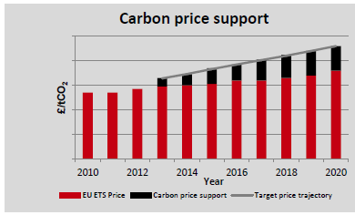
Carbon price policy (UK)
Carbon price support (£16/tCO2 in 2013, £30/tCO2 in 2020)
Why not at EU level? Energy Tax Directive

Slide 34
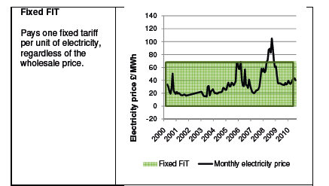
Models of feed-in tariff (1)

Slide 35
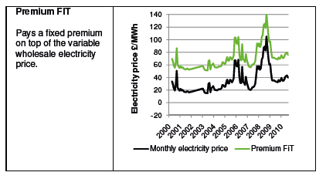
Models of feed-in tariff (2)

Slide 36
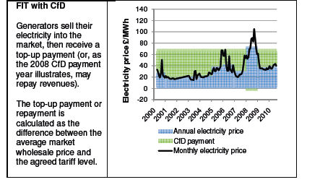
Models of feed-in tariff (3)

Slide 37
Combinations of policy instruments
  Market transformation
    Result of the combination of a number of policy measures affecting different actors, including: EU energy labelling; marketing campaigns (e.g. Energy Efficiency Recommended branding and advertising) by the Government and its agencies (e.g. EST); consumer advice from Energy Efficiency Advice Centres; media coverage on climate change; retail staff training and point of sale material from the EST; EU Minimum Performance Standards; EEC funding for incentives for consumers to purchase the energy-efficient models.
  EU Integrated Product Policy
    Sustainable Consumption and Production (SCP); state aid; voluntary agreements; standardisation; environmental management systems; eco-design; labelling and product declarations; greening public procurement; encouragement of green technology; and legislation in areas including waste and chemicals.
  SCP (see next slide)

Slide 38
UK SCP Strategy
Products | Strengthening domestic and international measures to improve the environmental performance of products and services, including improved product design
Production | Improve resource efficiency and reduce waste and harmful emissions across business sectors
Consumption | Influence consumption patterns, including proposals for new advice for consumers
Procurement | Sustainable procurement in the public sector, to make the UK a leader within the EU by 2009
Innovation | Support for innovation to bring through new products, materials and services
Sustainable business | Increase transparency, corporate responsibility and skill in business and other organisations
Waste | Increased emphasis on reducing waste at source and making use of it as a resource

Slide 39
Policy effectiveness
  Relative, but not absolute, carbon decoupling (carbon emissions rose in UK from 1997-2007, despite Climate Change Programme policies)
  Issue of consumption (as opposed to production/ territorial) emissions
  (Much) More stringent application of policy instruments (especially price-based to avoid rebound effects) seems to be required
  Threat from shale or cheap natural gas (‘Gas Strategy’)
  Implications for economic growth
  Political feasibility

Slide 40
Possible UK timeline, 2010-2050 (1)
2010-2020:
Actual UK response to the EU Renewables Directive
Supply-side options are clarified (In EU how much beyond 20% renewables? Does CCS work? Which countries will go for nuclear? How much distributed generation?)
Trajectory of demand reduction is clarified
Trajectory of electrification of personal mobility and residential heat is clarified
Demand response technologies are installed
Requisite institutional reforms (e.g Electricity Market Reform) are put in place
Internationalisation agreements are put in place

Slide 41
Pipeline of selected energy technologies showing progress required by 2020
Source: Energy Research Partnership 2010 Energy innovation milestones to 2050, March, ERP, London www.energyresearchpartnership.org.uk/tiki-download_file.php?fileId=233

Slide 42
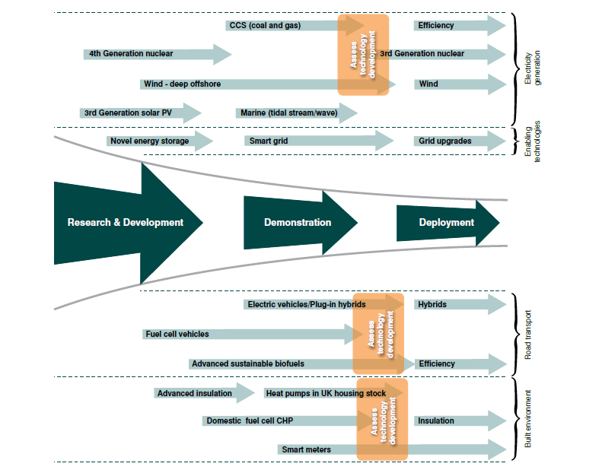

Slide 43
Possible timeline, 2010-2050 (2)
2020-2030:
Large-scale roll out of different supply technologies
Establishment of new demand patterns
Roll out of grid redesign
Re-think/re-orientation where possible/desired to take account of new technologies and options
2030-2050:
Large-scale deployment of chosen options
Limited scope for trajectory change without large costs

Slide 44
CECILIA2050 Detailed Conclusions
The EU climate policy mix is uneven, lightly co-ordinated and difficult to define
However, it has been effective in producing CO₂ abatement - EU ETS, RES-E support mechanisms and Environmental Tax Reforms (ETRs) introduced by Member States since 1995 reduced CO₂ emissions in 2008 by up to 12-13% below the counterfactual in some Member States
Economic instruments are key, but not sole drivers of policy-induced CO₂ abatement
There is no evidence that ‘carbon leakage’ from the EU has occurred
From a broad perspective, key EU climate policy instruments were economically neutral at worst – and probably beneficial
(extensive literature and evidence)
Notes:
Support scheme design – most use feed-in tariffs as key instrument, but very different specific designs and other enabling measures and operating contexts

Slide 45
CECILIA2050 Overall Policy Conclusion
Policy mix ‘optimality’ is inconsistent with the politics of implementation, but improvements are possible
Trade-offs between the three aspects of ‘optimality’ (‘effectiveness’, static and dynamic ‘efficiency’ and ‘feasibility’), is unavoidable in practice
Effectiveness and cost-efficiency of an instrument or instrument mix is often determined, along with the ability to introduce an instrument in the first place, by political feasibility.
Political feasibility (at all levels) is subject to rapid change – options must be on the table ready for introduction when circumstances are favourable
No reason for thinking that EU climate policy has put EU economy at a competitive disadvantage

Slide 46
Thank you
p.ekins@ucl.ac.uk
www.bartlett.ucl.ac.uk/sustainable

